Slide 1
Can it work?
Discovering if your good idea to introduce a new thing in an interconnected world
will yield sufficient value for it to work

Slide 2

Hult International Business School
Applied Business Blockchain, Web3 & next generation Holochain: Realising Value course – Adjunct Professor Stephen alexander
This is the first blockchain course in the world for business oriented professionals that allows business to drive the agenda rather than technology based strategies.
This will enable business professionals who have a good idea or need to evaluate the ideas of others when applying Blockchain, Web3 and the emerging peer to peer Holochain solution sets, to not only solve strategic problems and reduce operational pain but also to generate sufficient meaningful and verifiable value to each named stakeholder/actor for them to willingly and enthusiastically embrace and adopt the initiative.
2

Slide 3
Setting the bar....
Setting the new bar for business professionals, Digital Value Capture® practitioners trained in the Can it Work methodology, are able to assess which initiatives are the most likely to be adopted and deliver the most value/to the majority of stake-holders/actors and to succeed in delivering the required outcomes.
As industry begins to shift towards the new value-based economy, we will find that technology-driven strategies will no longer be a key driver.
2

Slide 4
Since the 1990s, each new technology wave has brought greater business dependency to the point where technology solutions now define business strategies
However, history repeatedly shows that over 80% of these technology-driven initiatives fail to deliver upon the value equations used to justify the investment.
Unfortunately, the new blockchain based technology strategies have already demonstrated even greater levels of uncertainty, risk, legal and financial liability, which is likely to exacerbate this historical wicked problem.
By taking a value-driven business lead approach the opportunity exists to leverage the technical characteristics of Web3 to underpin rather than drive the agenda.
2

Slide 5
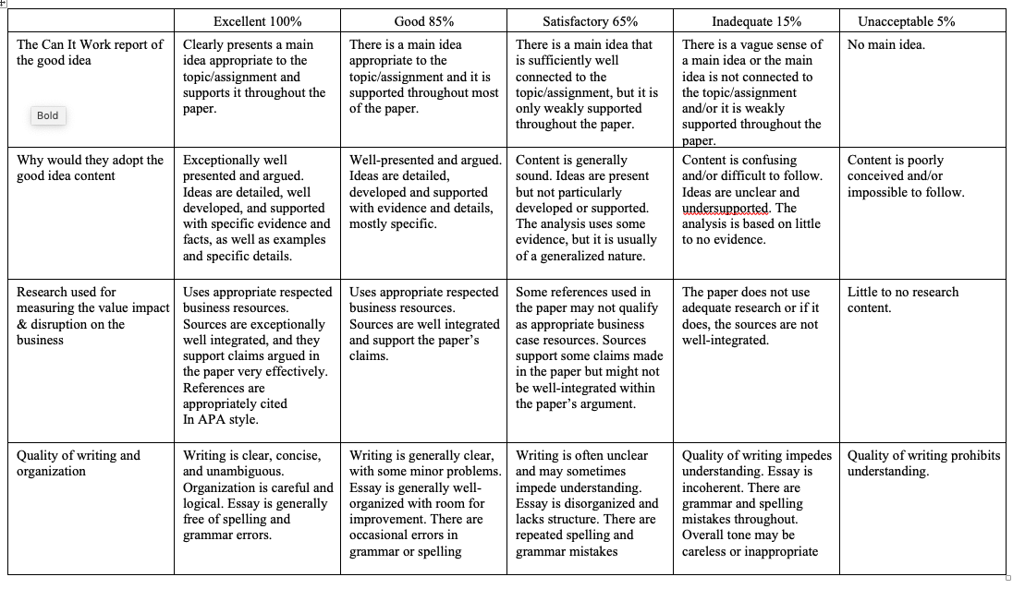
2

Slide 6
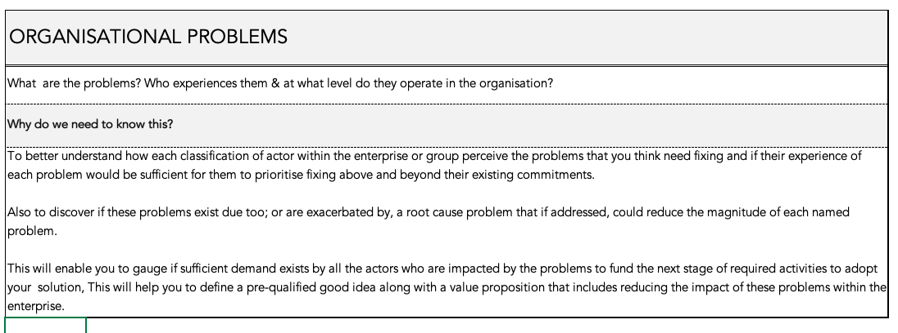
2

Slide 7
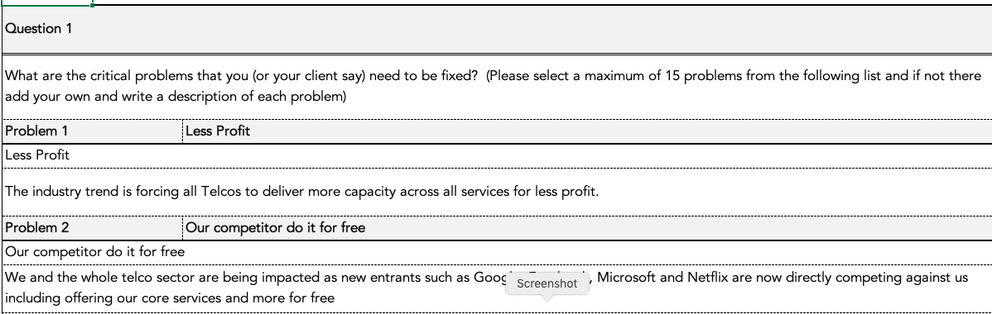
2

Slide 8
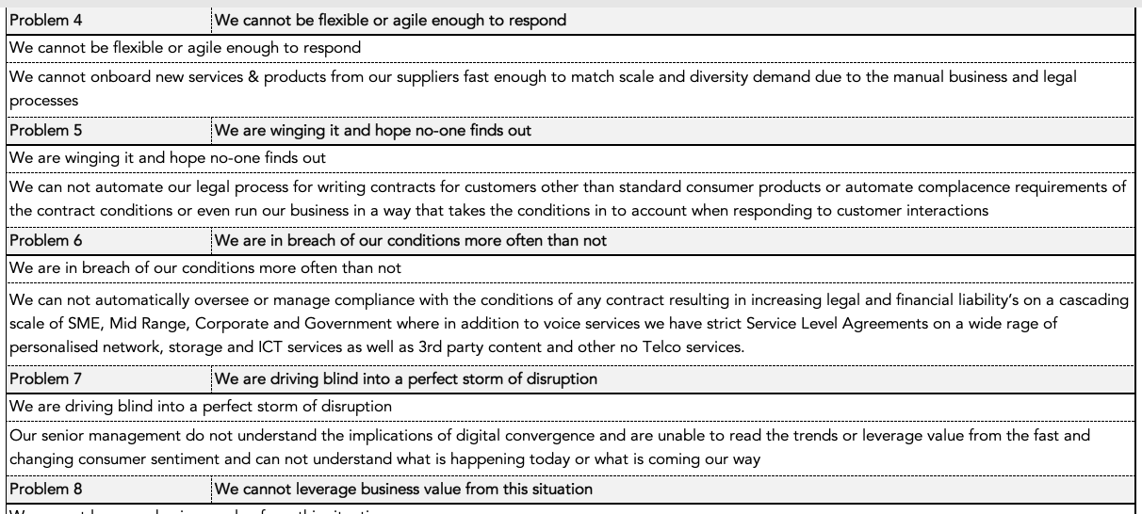
2

Slide 9
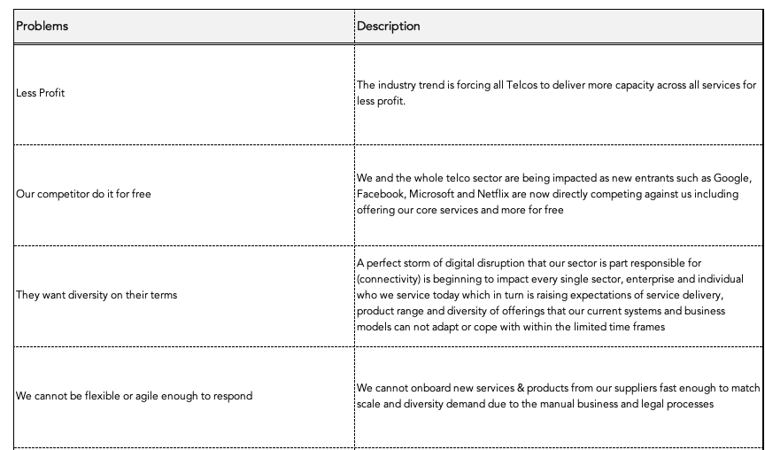
2

Slide 10
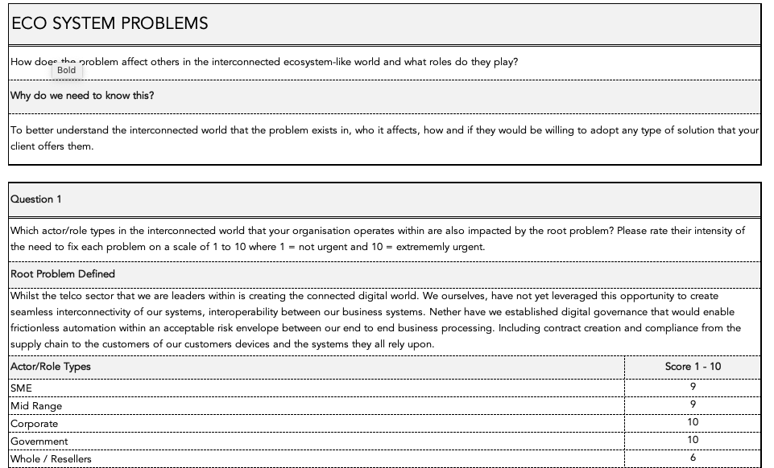
2

Slide 11
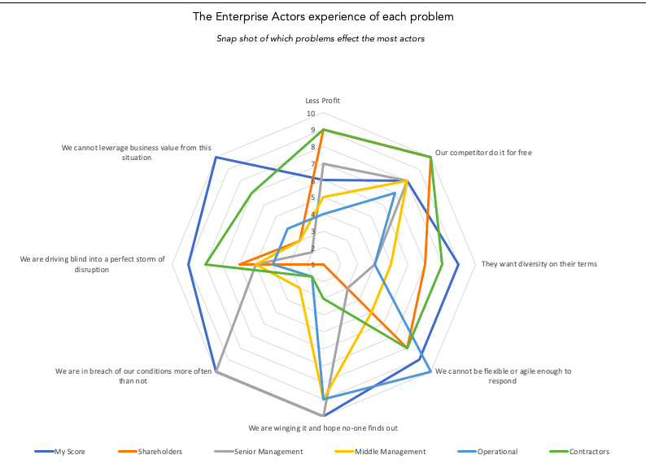
2

Slide 12
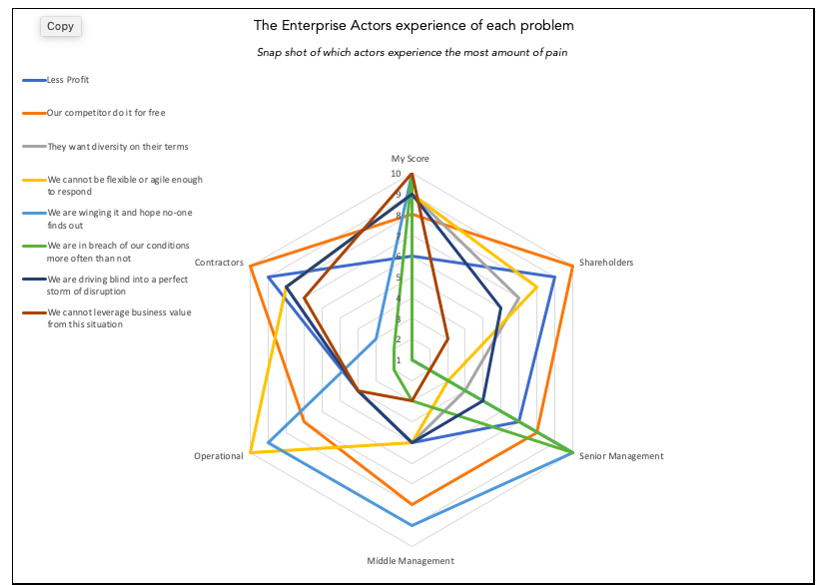
2

Slide 13
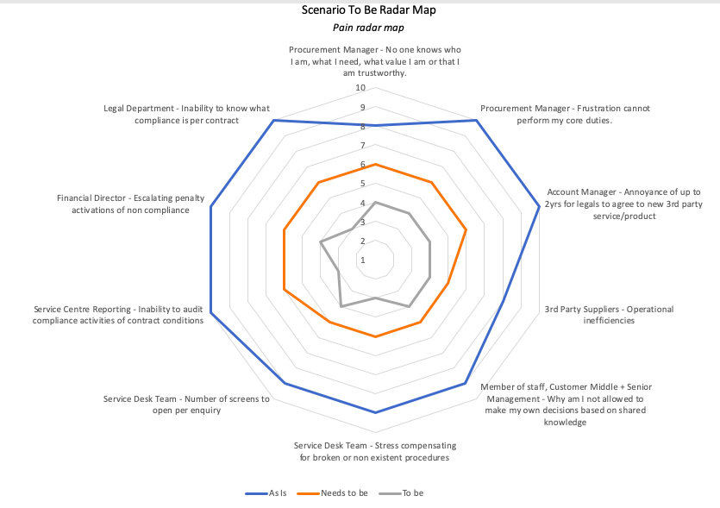
2

Slide 14
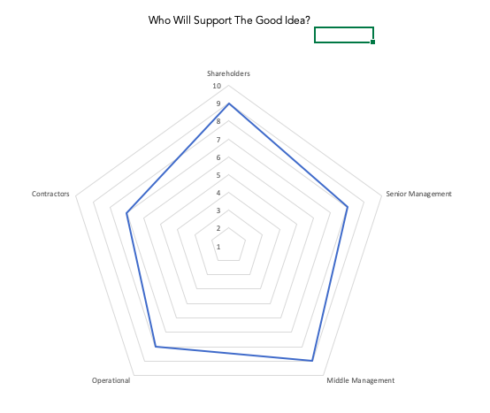
2

Slide 15
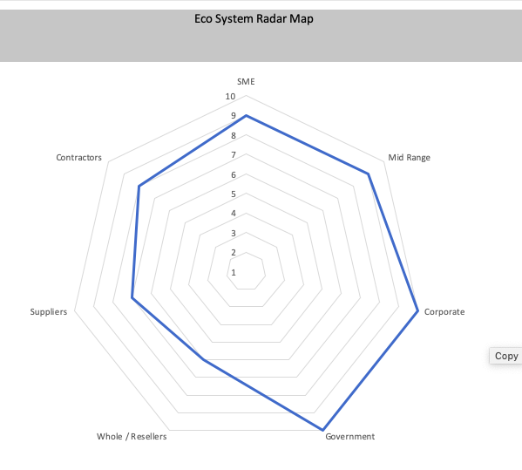
2

Slide 16
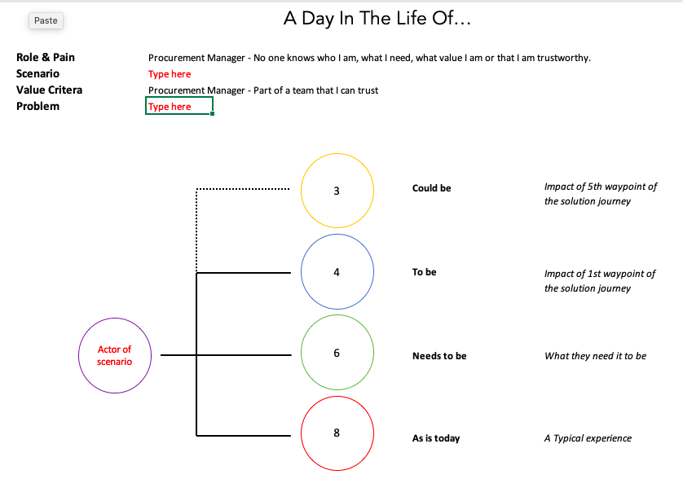
2

Slide 17
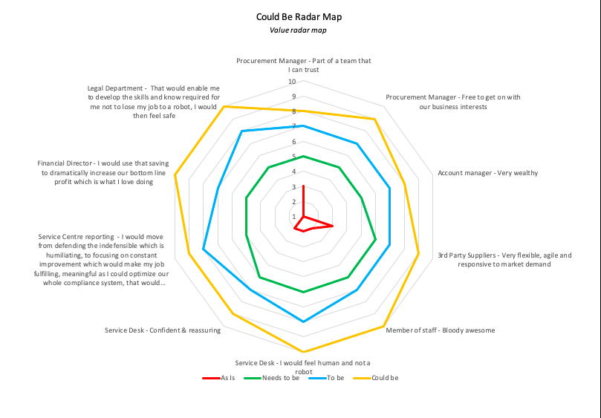
2

Slide 18
Can it work? Pain Equation Formula
Will it reduce the pain enough for me to use it?
TO BE
Per Spoke
= 10
Sweet Spot
rate
= 1
1
10
Low Value
High Pain
AS IS
Needs To Be
High Value
Low Pain
As is should be over 5.5
Sweet Spot
Need 0%
Plus weigh the ratio for need to be

Slide 19
Can it work? Value Equation Formula
Will it meet my aspirational needs?
TO BE
COULD BE
Per Spoke
Sweet Spot
Sweet Spot
1
10
Low Value
High Pain
AS IS
Needs To Be
High Value
Low Pain

Slide 20
Principles Framework for any collaborative contribution to the overall Transport environment
Overarching and prerequisite principles that can not be violated by any rule, process, decision or act and defines what should be prioritised by its contribution to strengthening the principles matrix
Governable
Trustworthy
Collaborative
Effective
Valuable
Smart Regional
Must contribute to the region’s aspiration to become digitally interconnected with everything that is willing & able to be part of the fusion of big data
Must enable the establishment of at least one single point of visualization to enable connected regional analytics of capacity, capability & intent of mobility
Must enable regional adaptability to be responsive to the needs of urban, rural & remote community needs
Must enable a state of non repudiation for any digital activity including;
Regulations, industry standards, business agreements and individual or group consent
Must demonstrate capacity to manage or mitigate existing and new risk & liabilities and not aggregate the liabilities to an unsuspecting new custodian
Must demonstrate harmonization with other jurisdictions or demonstrate equal enhancements with regard to safety
Must be fair, transparent and accountable
Must be able to validate a defined degree of truthfulness of a single or multiple data point and validate any automated equation and status in real-time and to meet any retrospective audit requirement of the business, governance or safety
Must enable any authorized party to retrospectively audit any transaction, record, equation or decision within the context of the associated compliance rules at the exact time of the transaction or as requested.
Must establish two way meaningful relationships with consumers, groups, crowds, communities and organizations as a means of better understanding if the preconditions for collaboration can be improved
Must underpin the development of a robust collaborative economy by way of enabling the aggregation of both demand and supply capacity of the region
Must foster a culture of collaboration within the workforce and any partnerships to a point where sharing becomes the first option
Must contribute to the regional ability to be be responsive, flexible and agile
Must contribute to optimize individual and regional multimodality including reducing congestion
Must engender a sufficiently skillful workforce to match or exceed the market requirements including knowledge, Skills,
Must be able to demonstrate the ability to estimate, predict and validate the tangible & measurable intangible value to each operational person/role (and collective value) of the introduction of any proposed new capability prior to any funding decision
Must be able to unlock existing identified value potential, generate new types of value from the fusion of digital information & services and create new digital intellectual property and algorithms that are recognized by credit rating criteria
Must demonstrate capacity to utilize the combined reginal value to enable benchmarking, operational KPIs in a manner that can be incorporated into new type of Public, Private, Regional and even including crowds in partnerships
© Roadmap methodology copyright of Stephen Alexander

Slide 21

Template for disruptive tipping points
Today
Mega trends & economic drivers as understood or embraced today
Individual Mega-trends & economic drivers maturity pathways & stages
A digital disruption tipping point
Your role is to look back
from the future
Please;
Illustrate a tipping point of converging trends describing how thing will never be the same
List your topics here
5

Slide 22
Principles Framework for any collaborative contribution to the overall interconnected environment
Overarching and prerequisite principles that can not be violated by any rule, process, decision or act and defines what should be prioritised by its contribution to strengthening the principles matrix

Slide 23
Thank you
Blog: www.stephenalexander.com.au

